Slide 1

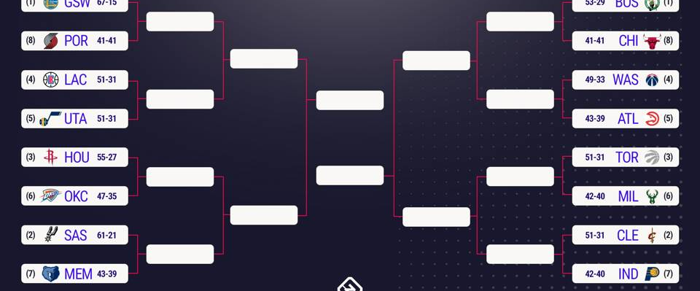
Predicting the 2017-2018 NBA Playoffs Presented by Nick Riffel, Geoffrey Holland, and Karsten Olson

Slide 2
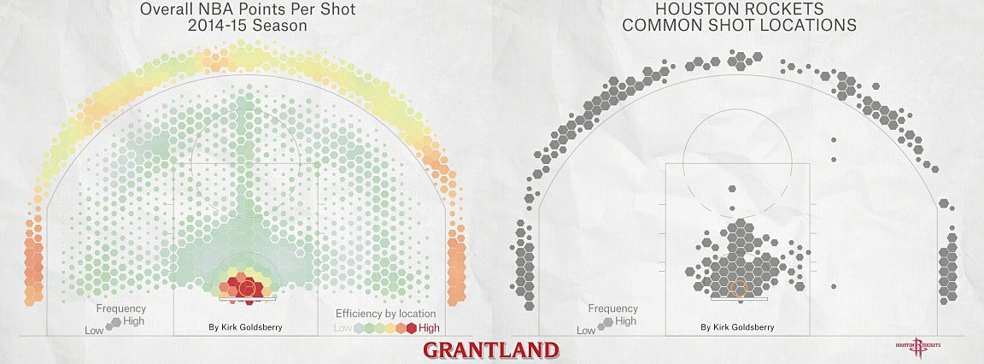


There is a fascinating history behind advanced sports analytics from Billy Beane of the Oakland Athletics to Daryl Morey of the Houston Rockets

Slide 3
John Hollinger
John Hollinger, an analyst at ESPN, former NBA executive, and nba analytics pioneer invented several stats that seek to tell more comprehensive stories about player and team performance.
His main contributions to NBA stats include:
TS%: True Shooting Percentage - what a player's shooting percentage would be if we accounted for free throws and 3-pointers. True Shooting Percentage = Total points / [(FGA + (0.44 x FTA)]
AST: Assist Ratio - the percentage of a player's possessions that ends in an assist. Assist Ratio = (Assists x 100) divided by [(FGA + (FTA x 0.44) + Assists + Turnovers]
TO: Turnover Ratio - the percentage of a player's possessions that end in a turnover. Turnover Ratio = (Turnover x 100) divided by [(FGA + (FTA x 0.44) + Assists + Turnovers]
USG: Usage Rate - the number of possessions a player uses per 40 minutes. Usage Rate = {[FGA + (FT Att. x 0.44) + (Ast x 0.33) + TO] x 40 x League Pace} divided by (Minutes x Team Pace)
ORR: Offensive rebound rate
DRR: Defensive rebound rate
REBR: Rebound Rate - the percentage of missed shots that a player rebounds. Rebound Rate = (100 x (Rebounds x Team Minutes)) divided by [Player Minutes x (Team Rebounds + Opponent Rebounds)]
PER: Player Efficiency Rating is the overall rating of a player's per-minute statistical production. The league average is 15.00 every season.
VA: Value Added - the estimated number of points a player adds to a teamâ€™s season total above what a 'replacement player' (for instance, the 12th man on the roster) would produce. Value Added = ([Minutes * (PER - PRL)] / 67). PRL (Position Replacement Level) = 11.5 for power forwards, 11.0 for point guards, 10.6 for centers, 10.5 for shooting guards and small forwards
EWA: Estimated Wins Added - Value Added divided by 30mated number of wins a player adds to a teamâ€™s season total above what a 'replacement player' would produce.

Slide 4
Our Methodology
NBA Offensive Efficiency and Defensive Efficiency according to Hollinger =
Offensive: points per 100 possessions
Defensive: allowed points per 100 possessions
Our calculation according to Chris Burrows of sportsrec.com is:
Total points scored/total possessions
Total points allowed/total possessions
Possessions are calculated as follows:
field goals attempted - offensive rebounds + turnovers + (0.4 x free throws attempted) = total number of possessions for the season. This works because a possession can end only in one of three ways: an attempted field goal, a turnover or a free throw, with an offensive rebound negating additional field goal attempts.

Slide 5
Our Methodology Cont’d
Net Rating
Offensive rating-defensive rating
We decided this is the most effective measure of a teams performance because it encapsulates multiple stats for both offensive and defensive statistics.
Run a regression analysis using Net Rating and Possessions in each of the 82 NBA Regular season games.
Identify the y-axis using the average number of possessions in an NBA game to compare team’s Net Ratings at specific number of possessions. In our case, the average number of possessions in an NBA playoff game is 98.77 and 93.3 in an NBA finals game.
The winner of the first two rounds of our playoff projection are being measured at 98.77 possessions per game, while the finals are being evaluated at 93.3

Slide 6
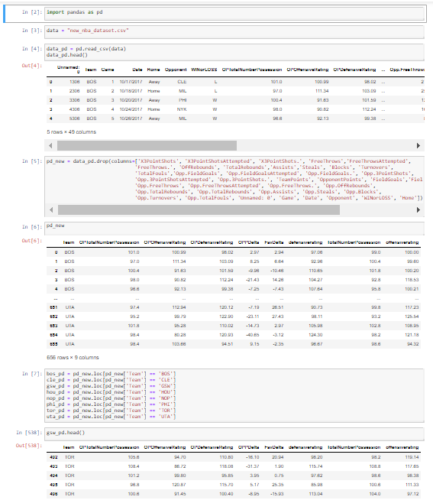

Slide 7
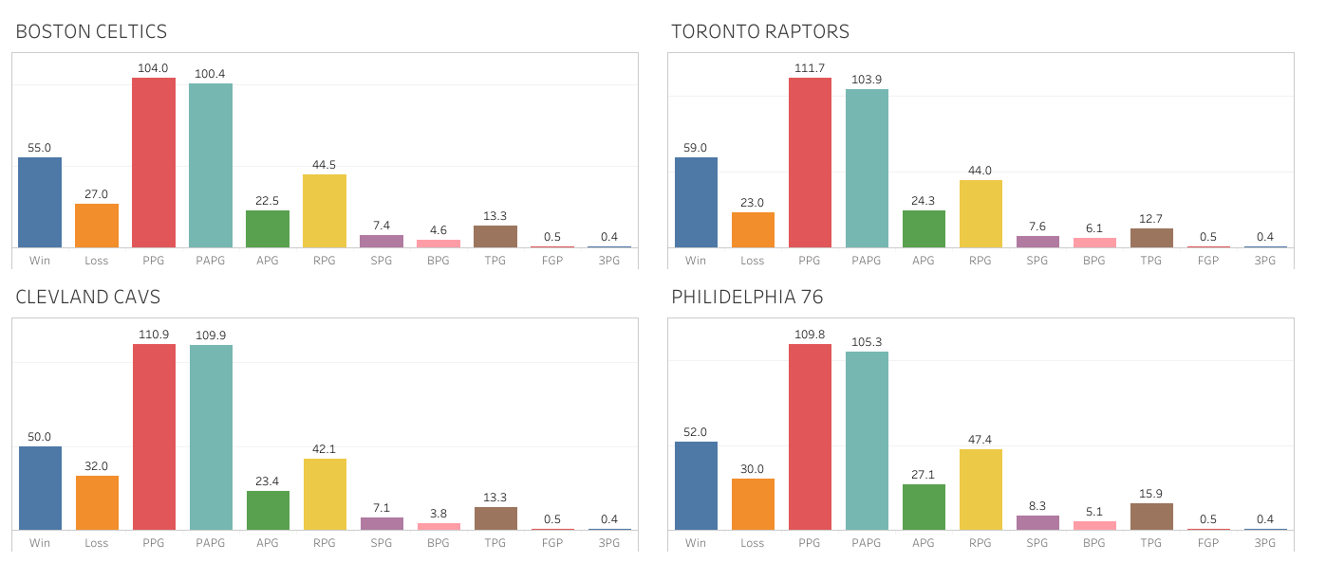
Eastern Conference Data

Slide 8
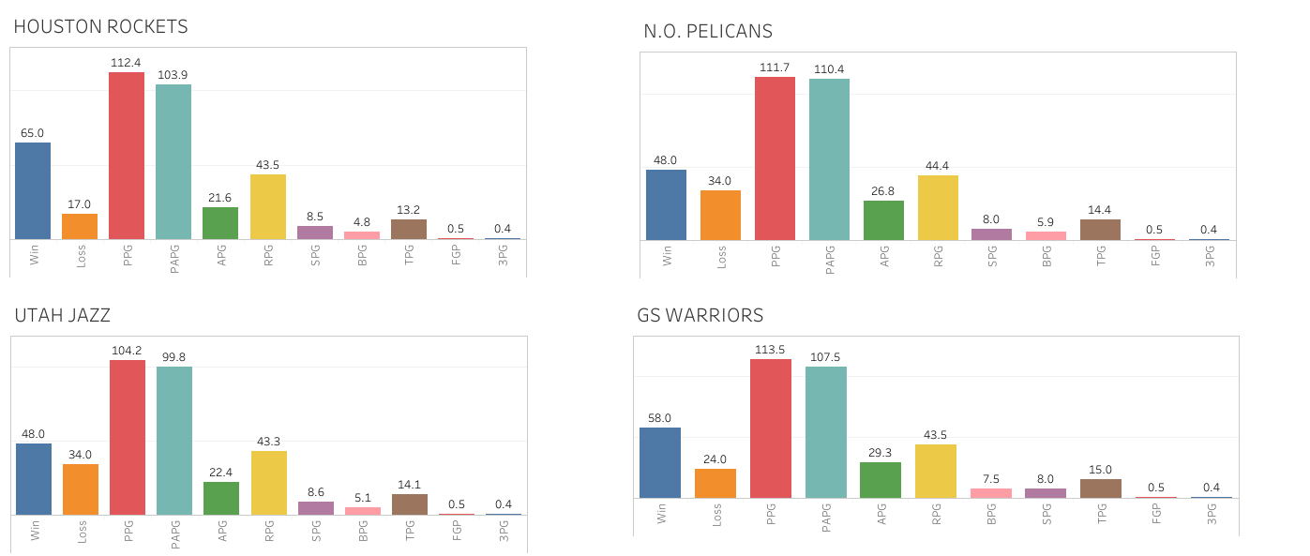
Western Conference Data

Slide 9
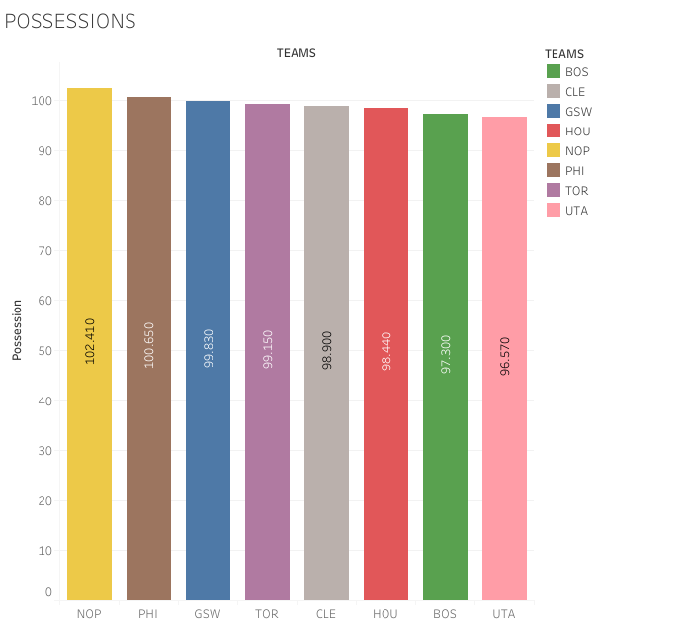

Slide 10
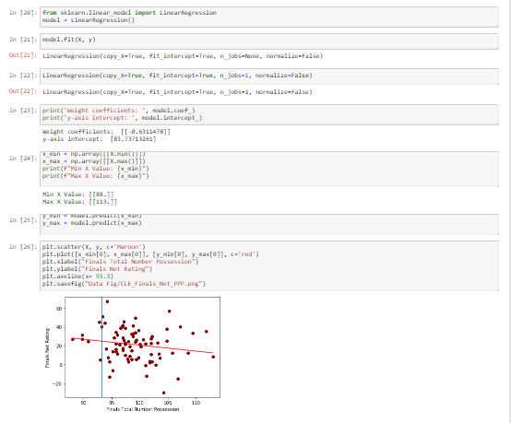

Slide 11
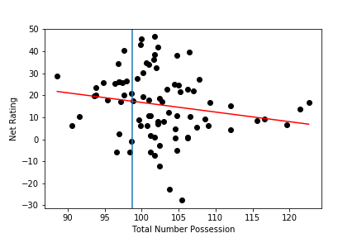
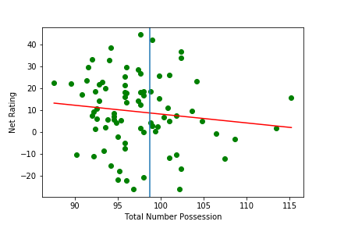
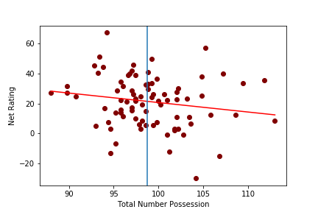
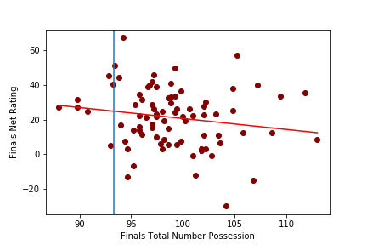
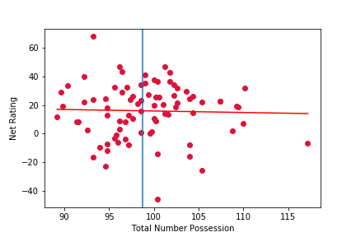
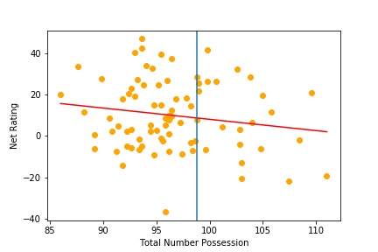
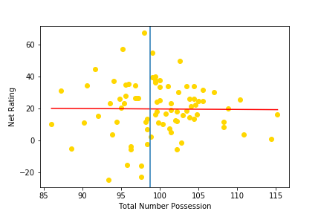
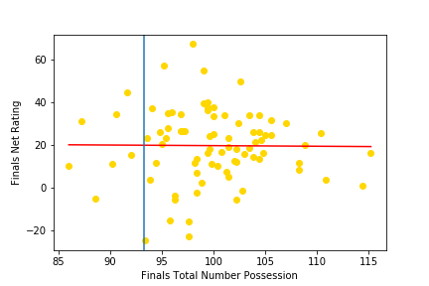
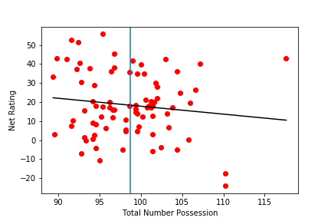
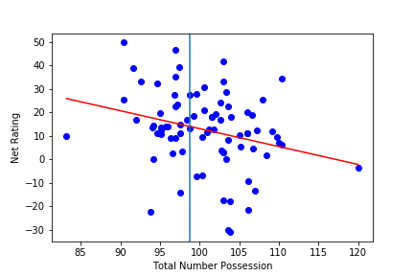

Slide 12
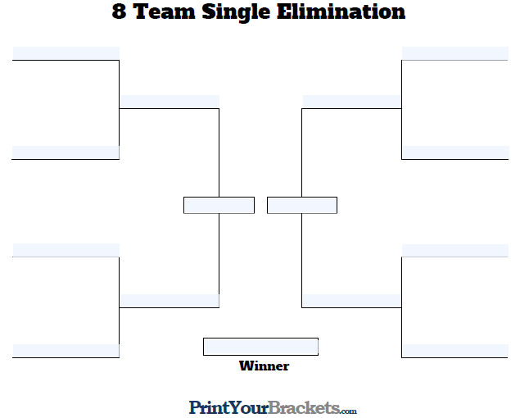









Slide 14
If we did it all over again… or just had more time
Ways we could refine our findings and get more specific predictions:
Use regressions of Net Ratings by match ups
Use average number of possessions between match ups to acquire y-axis
Use one of the NBA API’s to create a live database that is constantly updating with this relevant information and create a live interface to isolate certain statistics
Weigh our findings against average player PER to see which is more accurate

Slide 15
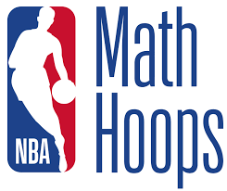
Practical Application
Why does this matter? What do coaches, GM’s, owners, and other parties do with this data?
Strategy development
Player development
Game plan
Scouting

